Slide 1
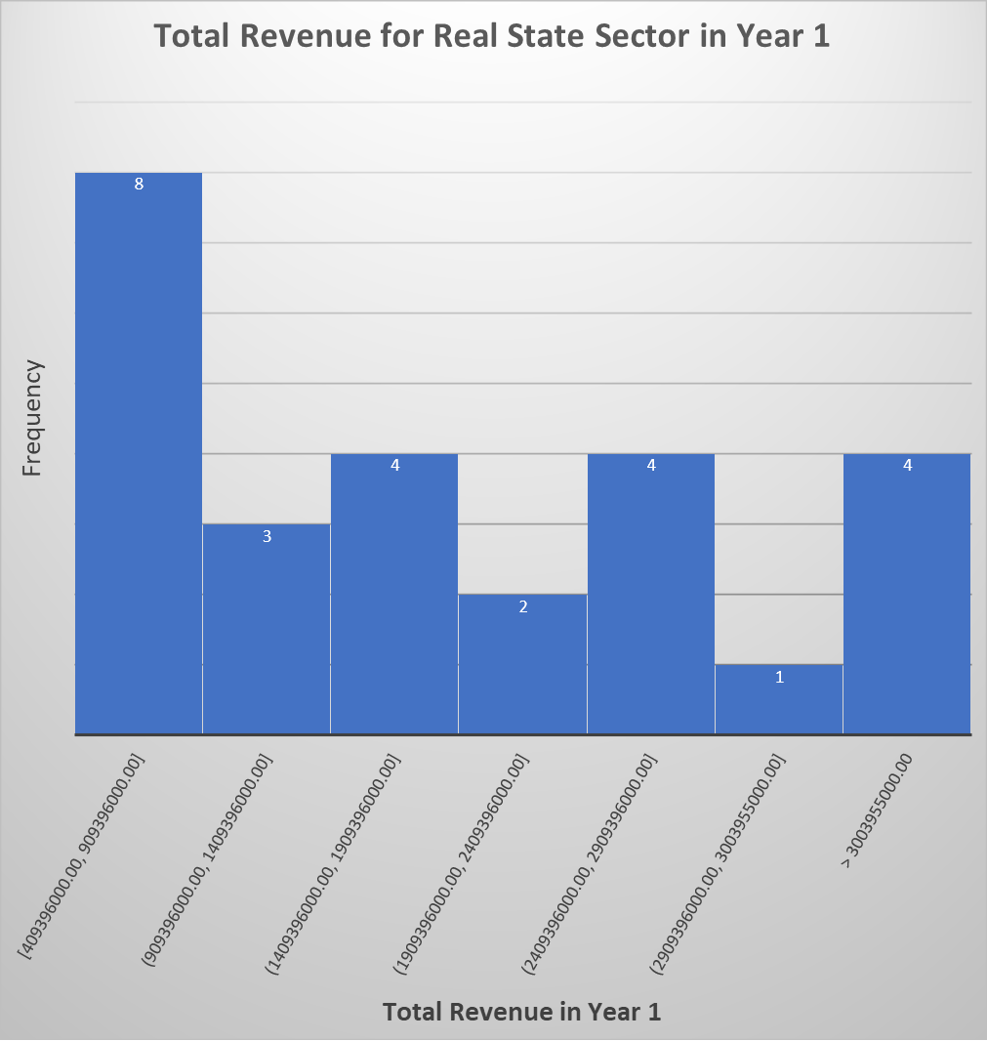
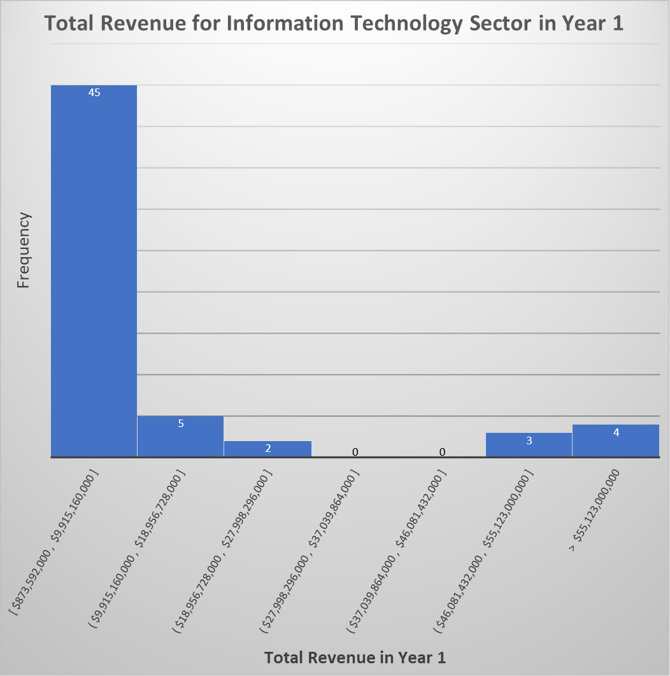
Does the total revenue in the information technology sector is higher than real state sector in Year1?
<visualization or summary statistics used for finding>
Here are the histogram for the annual total revenue for Information Technology companies and Real State companies in Year 1
The distribution of information technologz sector revenue is right skewed, which means that the mean is greater than the median. On the other hand, the revenue distribution in the real state sectoe is skeweless.
The mean total revenue value in the IT sector ($ 15,546,943,136) is higher than the mean value in the real state sector($ 2,115,778,769). Moreover, the median value in the IT Sector ($ 4,436,000,000) is more than double the median vlue in the real state sector($ 1,806,582,500 ). Finally, the standard deviation of the it sector ($ 30,875,723,621 ) is also 18 times more than the standard deviation in the real state sector($ 1,683,460,381 ), which mean there is a tremendous variablity in the companies' total revenue in the IT sector compared to the real state sector.

